Slide 1
Clock Synchronization
State of Art
By,
Vaishnavi Papudesi Babu

Slide 2
Summary
Base paper: HUYGENS - Exploiting a Natural Network Effect for Scalable, Fine-grained Clock Synchronization
Total papers read: 58
Found Relative: 16
PPT: 10
Others: Github Notes

Slide 3
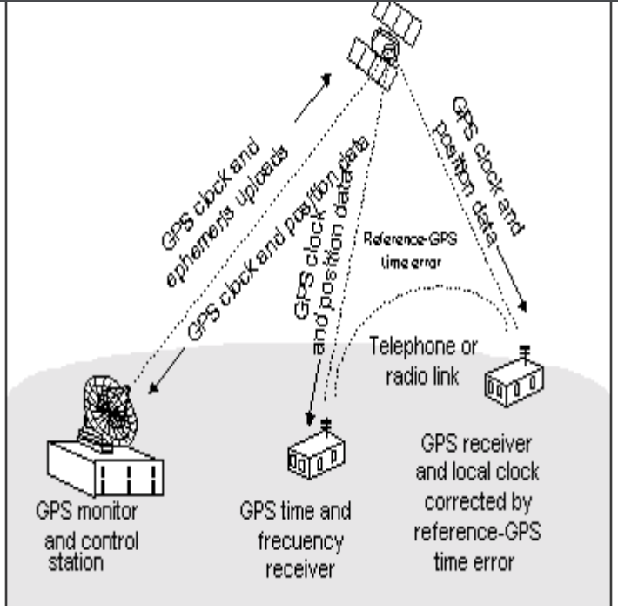
Global Positioning System(GPS) First launched: 1978
Developed by U.S. Department of Defence, provides precise time information.
Each GPS satellite contains multiple atomic clocks that contribute very precise time data to the GPS signals.
Determine time with an accuracy of within 100 billionths of a second.
To receive PPS signal from GPS receiver, it should be installed on a roof with a clear view to the sky.
Drawback: Expensive to deploy at scale
Hence, widely used in stratum 0 zone in NTP and as ref clock in PTP
Notes:
The 1 PPS(pulse per second) signal frequency is 1Hz, which is used to indicate the whole second

Slide 4
Network Time Protocol (NTP) Established: 1985
The Need for NTP: A Survey Revelation
    Among 94,260 hosts of the Internet system,
              About half had time errors > 2 minutes
              10% had errors > 4 hours
              A few had errors over 2 weeks
Issues with Pre-NTP Clocks:
      Most clocks set manually using wristwatches
      Rarely checked for accuracy
      Quartz oscillator drift: up to 1 second/day
      Weeks between manual corrections
Many applications, especially distributed internet systems, require much greater accuracy and reliability

Slide 5
Overview
NTP
Client-server model
Organizes and maintains a set of time servers and transmission paths as a synchronization subnet.
Built on the Internet Protocol (IP) and User Datagram Protocol (UDP)
Provides a connectionless transport mechanism.
Designed to maintain accuracy and reliability, even over typical Internet paths involving multiple gateways and unreliable networks.

Slide 6
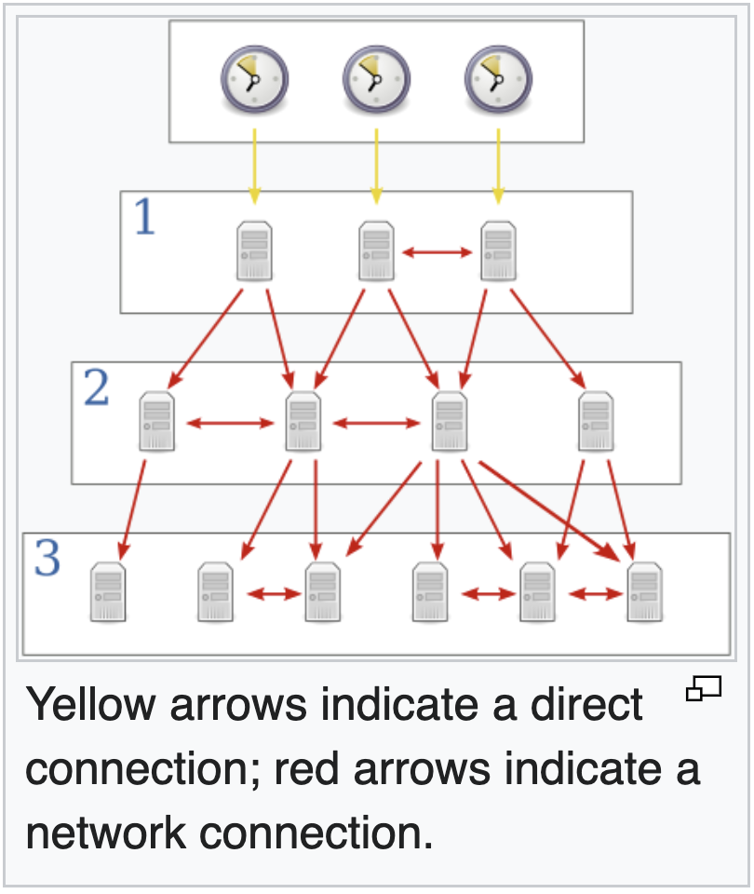
Synchronization Subnet
NTP
Stratum 0 is usually a timecode receiver or atomic clock.
A primary time server (Stratum 1) is directly synchronized to a primary reference source at Stratum 0
Stratum 2 servers are synchronized with Stratum 1 and so on..

Slide 7
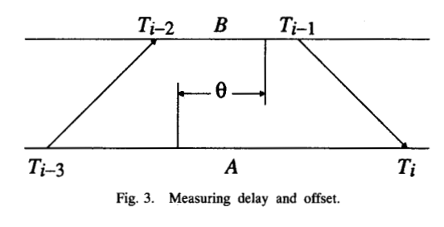
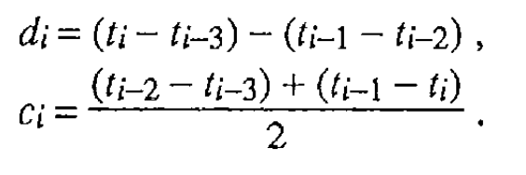
Algorithm
NTP
NTP client regularly polls one or more NTP servers
The client must compute its time offset c and round-trip delay d
Timestamps are stored as seconds
The client’s clock frequency is then adjusted to reduce the offset gradually
Achieves millisecond level accuracy.

Slide 8
Precision Time Protocol IEEE 1588; Established: 2002
For time critical applications, millisecond-level accuracy provided by NTP is not sufficient.
Also, NTP is software based.
The network latency will critically impact the accuracy.
Hence, raised a need of higher precision time protocol.

Slide 9
Overview
PTP
A Master - slave model
Synchronize clocks of packet-switched network to a “Grandmaster”
Relies on hardware-based time stamping mechanisms using network switches, Network Interface Controllers(NICs) etc.

Slide 10
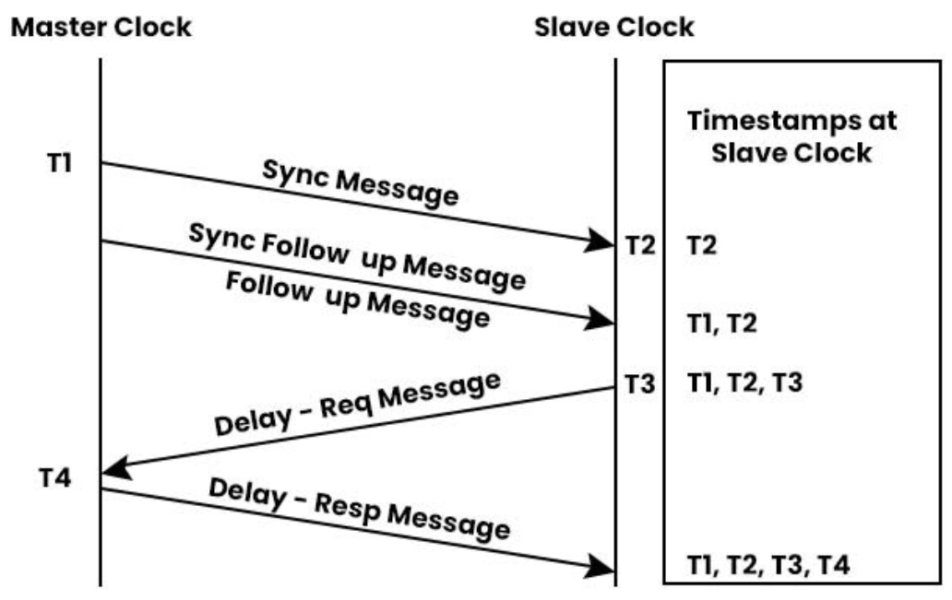
Overview
PTP
Slaves adjust their clocks based on the calculated offset to synchronize with the master clock.
Master to Slave difference = T2 – T1
Slave to Master difference = T4 – T3
One-way delay = (Master to Slave difference
+ Slave to Master difference) / 2
Offset = Master to Slave difference – One-way delay
Achieves accuracy in sub microsecond precision
Notes:
PTP employs a two-way time transfer mechanism, where both the master and slave exchange timing messages (Sync, Delay_Req, Delay_Resp, and Follow_Up) to measure the propagation delay and determine the clock offset.

Slide 11
Datacenter Time Protocol paper release: 2019
Motivation 1
Impact of Round-Trip Times (RTTs) on time synchronization
  Fundamental to accurate time synchronization
  Lower, consistent RTTs lead to better synchronization precision
Traditional protocols have inherent limitations to meet stringent precision
  Network jitter
  Packet buffering
  Network delays
  Network stack overhead
Hence, there is a need to have nanosecond precision with no protocol message overhead.

Slide 12
DTP
Motivation 2
External Synchronization
Synchronizing to true time (e.g., atomic clock, satellite)
Externally synchronized clocks are also internally synchronized, but not vice versa
Internal Synchronization
Synchronizing with peer processes, with or without regard to true time
Most data center applications require relative time consistency.
Can achieve higher precision eliminating external network delays and uncertainties
Eliminates need for expensive external time source hardware utilizing existing data center infrastructure
  Examples:
  Measuring one-way delay,
  Processing time,
  Ordering global events
Hence, there is a need to achieve internal synchronization with high precision
Notes:
The examples in internal synchronization does not need true time.

Slide 13
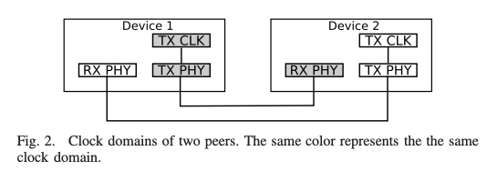
Contribution
DTP
DTP provides clock synchronization of all clocks in a datacenter with high precision leveraging physical layer of network stack eliminating non-determinism from measuring RTTs
Use PHY to synchronize clocks because,
  Two peers are already synchronized.
  No network overhead
  Scalable
RX path recovers clock from TX path of sending peer's PHY
Creates a "virtual circuit" of synchronized clocks

Slide 14
Implementation
DTP
According to IEEE 802.3ae, a 10GbS ethernet PHY consists of 66-bit Control block (/E/) and 8 7-bit idle characters (/I/)
The standard requires at least 12 /I/ interpacket gap so there is at least one /E/ block between packets.
/E/ blocks are sent continuously if no ethernet frames to send.
DTP uses /I/s in the /E/ control block to deliver protocol messages.
Upon processing, DTP replaces /E/ blocks with required /I/s

Slide 15
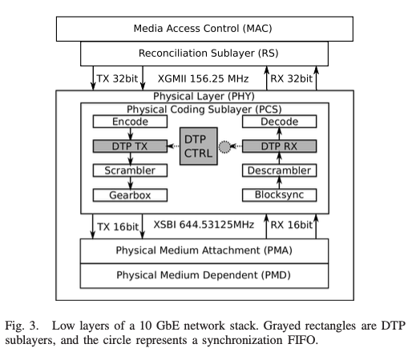
Implementation
DTP
Each DTP component (TX, CTRL, RX) integrates with the PCS sublayer
DTP TX(Transmit Path) inserts protocol messages into the data stream.
Uses the same oscillator as other modules in the PCS, ensuring consistent clock domain.
Protocol message is 3-bit message type+53-bit payload.
Message types: INIT, INIT-ACK, BEACON, BEACON-JOIN, BEACON MSB
Payload: Part of the local counter of the sender

Slide 16
Implementation
DTP
DTP RX(Receive path) processes incoming protocol message and forward to control logic.
Replace DTP messages with idle characters after processing

Slide 17
Implementation
DTP
DTP CTRL(Control Logic) manages synchronization logic and local clock counter.
Adjust clock based on received BEACON messages

Slide 18
Deployment – Hardware changes
DTP
Best implemented inside the switching chip.
DTP-enabled switches create a DTP-enabled network.
PTP uses a similar approach to improve precision
Hence, deployment cost is similar to Precision Time Protocol (PTP).
Alternatively, use FPGA-based NICs and switches for flexible firmware updates.
Implement customized PHYs with high-speed transceivers.
Incremental deployment by updating racks and switches in stages.

Slide 19
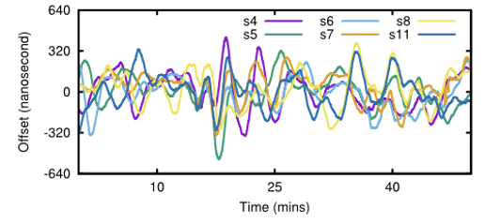
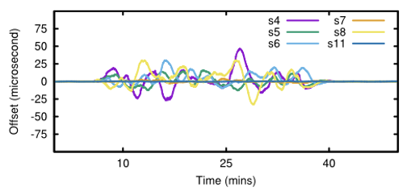
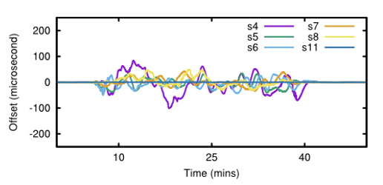
Evaluation - PTP
DTP
Idle Network (No Network Traffic) - Clocks differ by a few hundred nanoseconds
Medium Loaded Network (4Gbps Traffic) - Clocks differ by tens of microseconds
Heavily Loaded Network (9Gbps Traffic) - Clocks differ by hundreds of microseconds

Slide 20
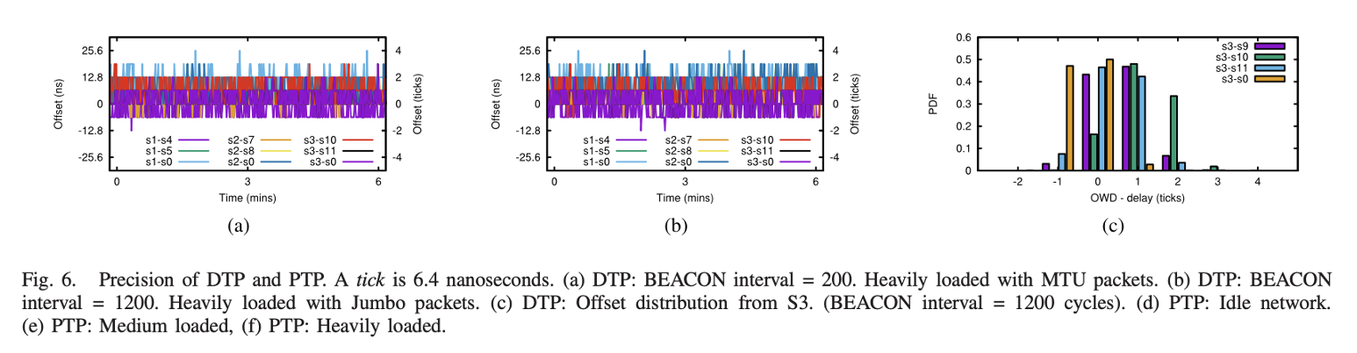

Evaluation - DTP
DTP
Clocks never differed by more than 4 clock ticks, 25ns Bounded Precision

Slide 21
Huygen: Exploiting a Natural Network Effect for Scalable, Fine-grained Clock Synchronization, 2018
Motivation
New applications are driving the need for very fine-grained clock synchronization with improved accuracy and lower cost compared to current solutions.
Example use cases:
  In distributed databases like Spanner, clock uncertainty (T) directly impacts write transaction latency and overall performance.
  CockroachDB showed that reducing clock uncertainty from 1ms to 100ns decreased read retry rates from 99.30% to 0.08%.
Current synchronization methods (NTP, PTP, PPS, DTP) either lack accuracy or require expensive hardware upgrades.

Slide 22
Contributions
Huygen
Comprehensive study of clock discrepancies in real-world networks.
HUYGENS and HUYGENS-R algorithms for offline timestamp alignment and real-time clock synchronization in distributed systems.
Proposal of a lightweight implementation that achieves high accuracy with minimal resource overhead.

Slide 23
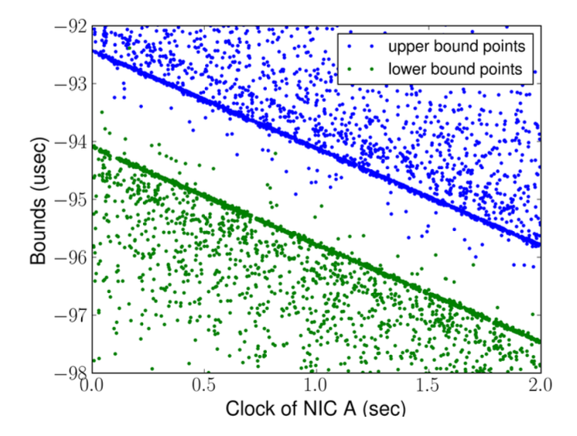
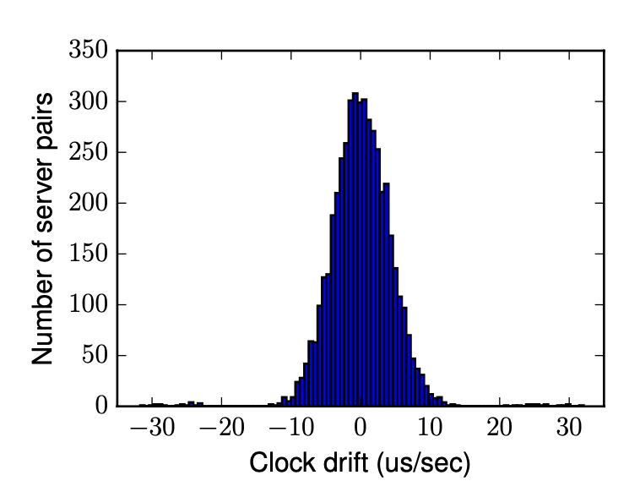
Study of clocks
Huygen
The clock offset between two servers in 2 second by coded probes.
Coded probe is 64-byte UDP packets between two servers forward and backword.
The average of the two intercepts is the offset between the two clocks
  - When clock A’s time is 0, clock B’s time is roughly −93.3μs.
The slope captures discrepancy in the clock frequencies.
Queuing delay
Negative delay
Zero queuing delay
Pairwise clock rates can differ by as much as 30μs/sec

Slide 24
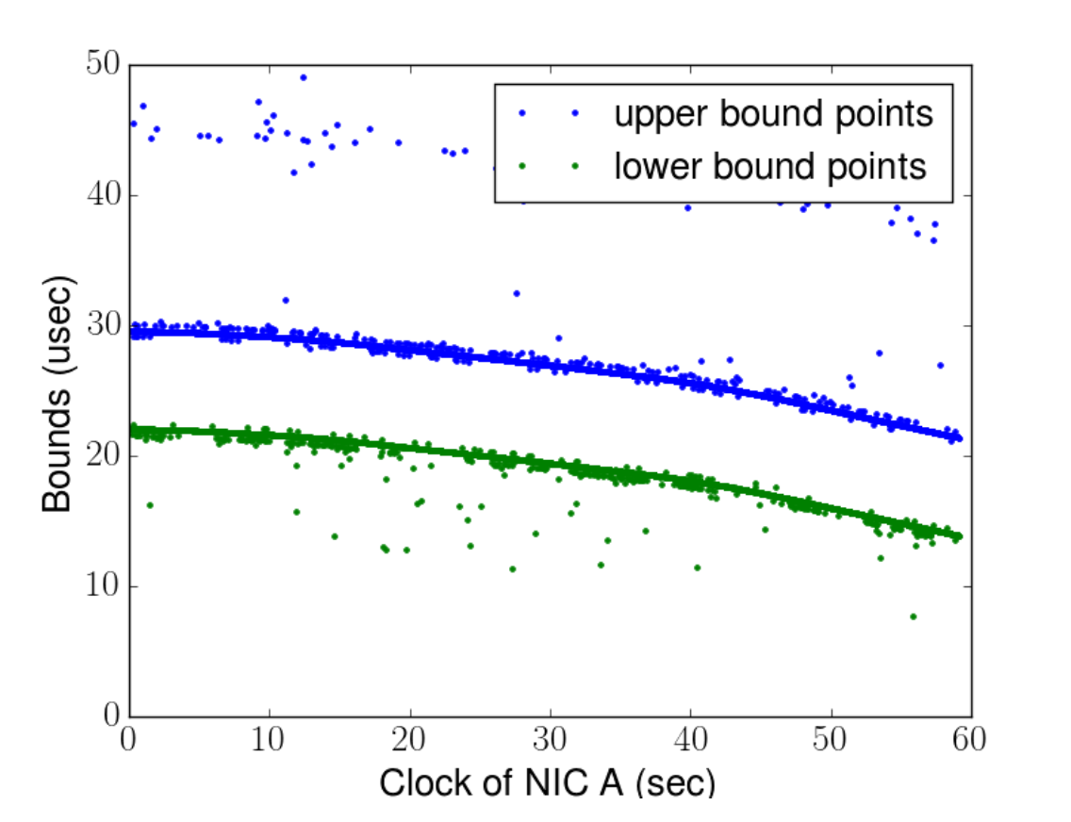
Study of clocks
Huygen
Nonlinearities are observed in longer timescales due to temperature changes
But it is essentially linear over 2–4 second intervals

Slide 25
Study of clocks
Huygen
Zero queueing delay points are captured even in cases when longer queueing delays are observed.
Timestamp noise can cause negative-delay which goes to forbidden zone.
Path symmetry is observed in multiple hopes between server pairs.
If Path asymmetry occurred, it can be resolved by replacing with symmetric paths.

Slide 26
Algorithm
Huygen
Clocks are connected through data center fabric.
Algorithm synchronizes clocks in a network every 2 seconds in a “progressive-batch-delayed” fashion.
At time 0 : Probe mesh is set up between the n clocks, each one probing K others.
At interval [0, 2): Collect probe data → (1)
At interval [2, 4): Process previous probe data, apply timestamp corrections at 1 second. → (2)
At [4, 6) repeat 1, 2 and so on.

Slide 27
Algorithm: 3 major steps involved
Huygen
Step 1: Coded probes
A coded probe consists of a pair of packets, P1 and P2 with transmit, receive timestamps t_{1,} t₂ and r_{1,} r₂
Pure Probes criteria: r₂ > r₁ and |(r₂-r₁)-(t₂-t₁)|< ε, where ε > 0
Pure: Both timestamps are retained if the probe pair meets the criteria.
Impure: Both timestamps are discarded if the probe pair fails the criteria.
Handling Dropped Packets: If either P1 or P2 is dropped, discard the coded pair.
Establishes probing graph with C1(initiator of probing) as the root

Slide 28
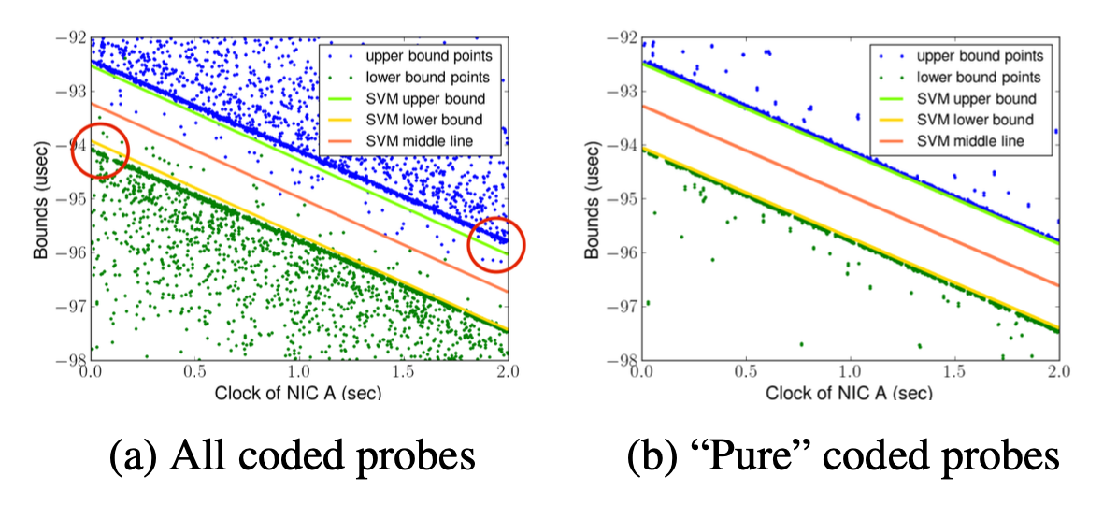
Algorithm
Huygen
Step 2: Support Vector Machines
SVM classifies the upper bound and lower bound points
Provided sufficient data points, SVM will return a straight line with a slope and intercept.
SVM performs well with pure probe data and inaccurately with noisy data.

Slide 29
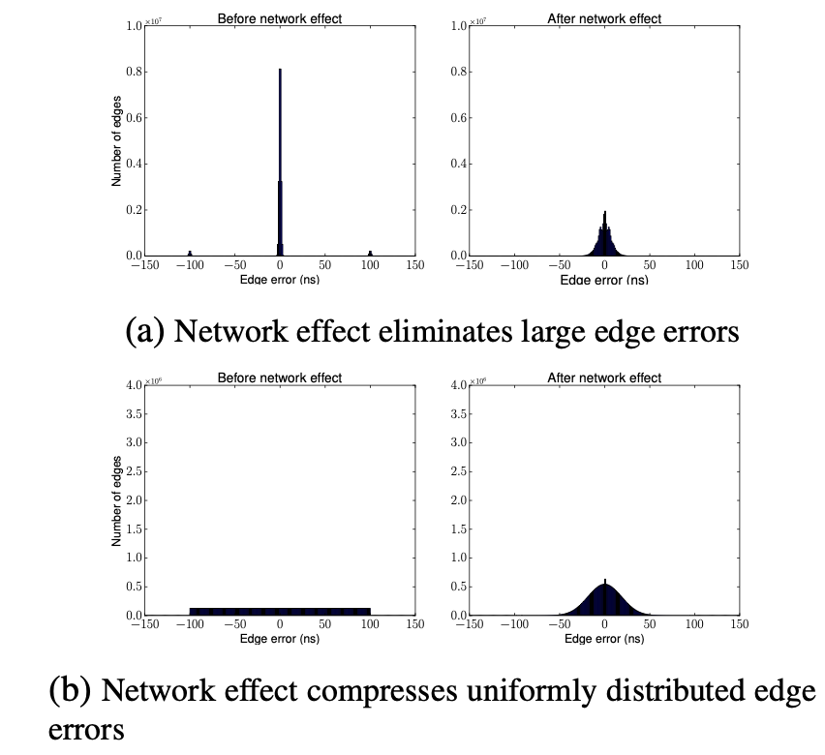
Algorithm
Huygen
Step 3: Network effect
Synchronize all clocks with C1 using Reference Spanning Tree in breadth first fashion
Network effect reduces the standard deviation of edge errors in:
The edge errors are typically small but sometimes can be as large as 100 ns
Distributed uniformly between -100 ns and 100 ns.

Slide 30
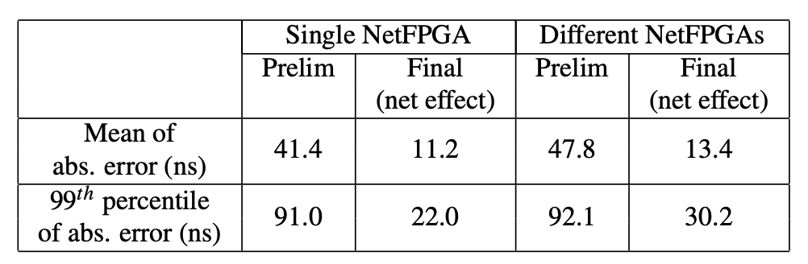
Evaluation
Huygen
Synchronization accuracy
In a 10-minute experiment, the network effect yields 3-4x improvement in accuracy of clock synchronization

Slide 31
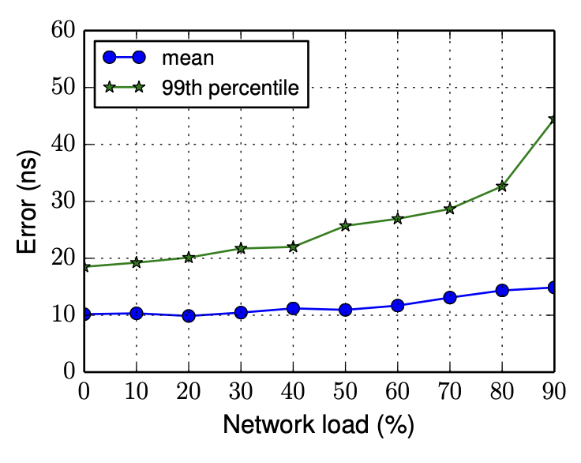
Evaluation
Huygen
Network load vs HUYGENS
At 90% load, HUYGENS synchronized clocks with 99th % error smaller than 60ns

Slide 32
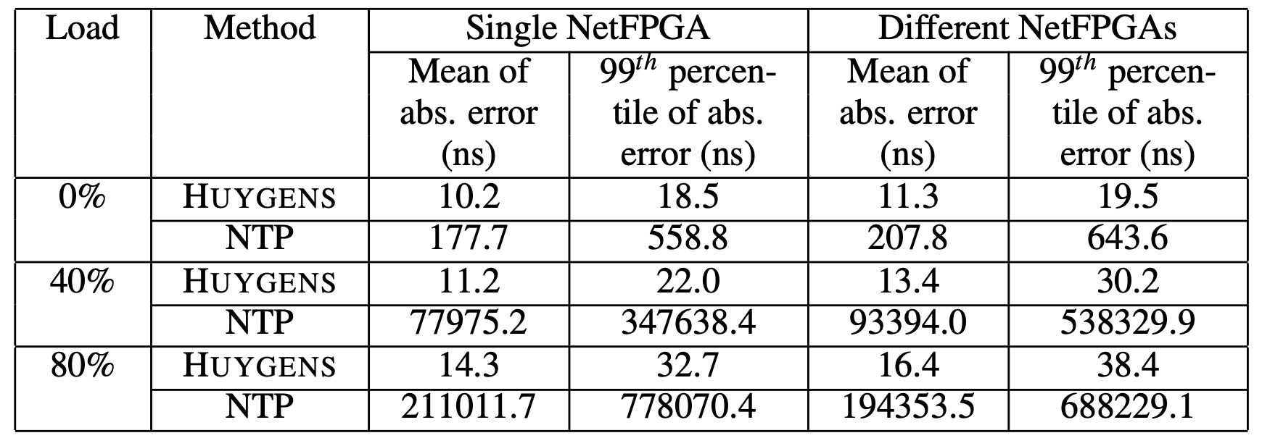
Evaluation
Huygen
Comparison with NTP
NTP’s error is 4 orders of magnitude larger than HUYGENS’s under medium to high network loads.

Slide 33
Conclusion
Huygen
HUYGENS is a software-based clock synchronization algorithm
Needs NICs for hardware timestamping
Achieves accuracy of 10s of nanoseconds even at high network loads
HUYGENS can scale the whole datacenter
In 40 Gbps data center, HUYGENS consumes around 0.05% of servers bandwidth and less than 0.44% of its CPU time

Slide 34
Note
A Novel Clock Synchronization System for Large-Scale Clusters seems to be in work in progress and it claims synchronization process is improved by 44.8% compared to Huygens. Suitable for large scale clusters.
Read more from notes

Slide 35
Communication-efficient Clock Synchronization
With the increased focus on clock synchronization, there us a need to improve the speed and reliability of implementation of synchronization techniques.
In HUYGENS algorithm, each server node exchange time information with its neighboring nodes and send to master node to run synchronization algorithm.
Servers and master should ensure timely communication to guarantee the sync accuracy.
Any communication overhead significantly affects accuracy of synchronization.
This paper identifies ways to reduce this communication cost.

Slide 36
Overview
Communication-efficient Clock Synchronization
In HUYGENS, the network is described by graph G = (V, E) where V is represent server nodes and E represent edge information.
The edge information is a weight representing approximate time discrepancy.
Each server node linearly codes the edge information and master node downloads the coded information from the servers to compute linear function.
The goal is to minimize the total amount of information downloaded by master node.
In other words, to minimize communication cost defined as the number of symbols communicated from all the server nodes to master node.

Slide 37
Implementation
Communication-efficient Clock Synchronization
This paper proposes coding scheme to minimize the communication cost in three different scenarios where edge information is known by
Both incident servers
One incident server
Few known by both incident servers and few by only one (case of huygens)
Implementation details are in the paper.

Slide 38
SSA - Motivation
Clock synchronization is essential for IoT devices, but achieving high accuracy is challenging.
In wireless channel, the probing signal can be disturbed by the channel noise.
IoT devices are weak in computation and communication.
Challenging to generate frequent and stable probing in limited time.
IoT devices lack the power to perform massive timestamp probing required for data-driven solutions.
SSA (Sliding window, Smoothing, and Adaptive correction) builds upon the Huygens algorithm, adapting it for IoT devices in WLAN environments.

Slide 39
Synchronization Algorithm Workflow
SSA Clock Synchronization
Continuous data collection
Sliding window data accumulation
SVM estimation
Smoothing of estimates
Stability check
Adaptive clock correction

Slide 40
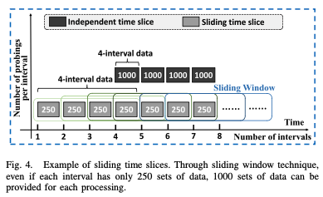
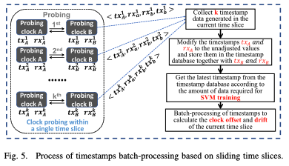
Algorithm
SSA Clock Synchronization
Sliding Window Technique
IoT devices can make only k probes at an interval, insufficient for SVM to calculate drift, offset.
Sliding window accumulates previous interval timestamps with the current window.
Current time slice data is adjusted according to the cumulative clock correction.
Send sufficient timestamp data to SVM to calculate offset and drift

Slide 41
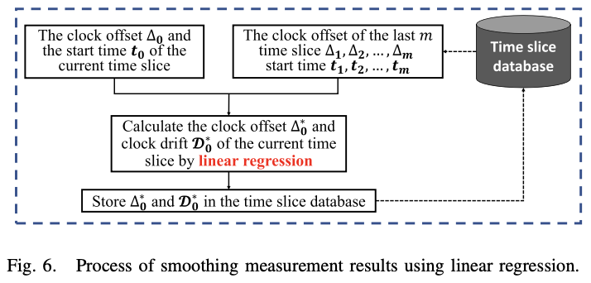
Algorithm
SSA Clock Synchronization
Smoothing Technique
Noise and inaccurate data from longer sliding window, causing fluctuations and instability of clock offset and clock drift.
Soothing technique is used to smooth out these fluctuations.
Linear regression data is offset(dependent variable), start time (independent variable)
New soothed clock offset and drift regression line are obtained.
This data is stored in database and clock correction is performed.

Slide 42
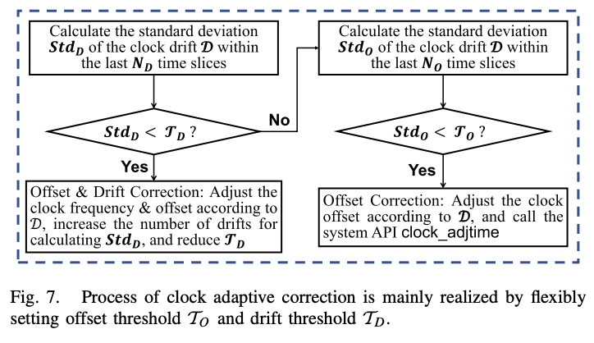
Algorithm
SSA Clock Synchronization
Adaptive Correction Technique
Initial boot-up phase lacks sufficient data points leading to ineffective SVM and smoothing
Algorithm checks the standard deviation of smoothed clock drift over short (N_{D} intervals) and long durations (N_{O} intervals).
If Std_{D} (short duration) < threshold T_{D}, correct both clock offset and drift.
If Std_{D} > T_{D}, check Std_{O} (long duration) against T_{O}.
If Std_{O} < T_{O}, correct only the clock offset.
If both Std_{D} and Std_{O} > thresholds, no correction is made.

Slide 43
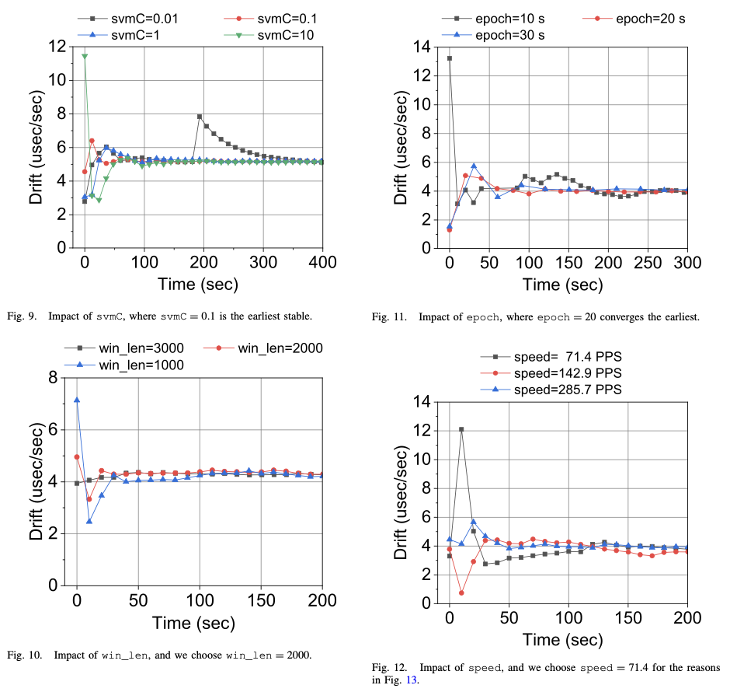
Evaluation - Parameter experiments
SSA Clock Synchronization
svmC is a parameter of SVM.
The larger svmC, the less error-tolerant the model, but overfitting may occur.
The smaller svmC, the more error-tolerant the model, but underfitting may occur.
Notes:
Directly evaluated on the Huawei Sound X smart speaker product using Huygens algorithm as the baseline for comparison.

Slide 44
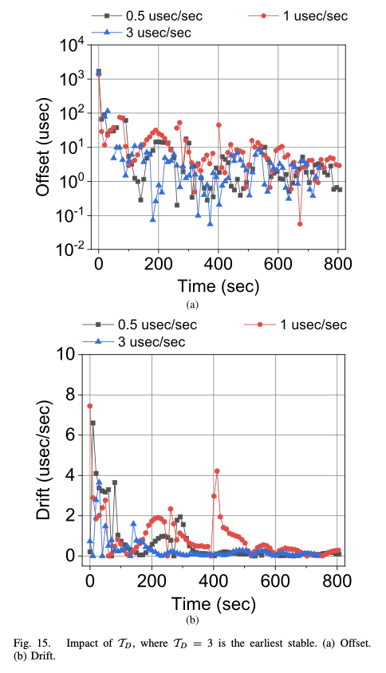
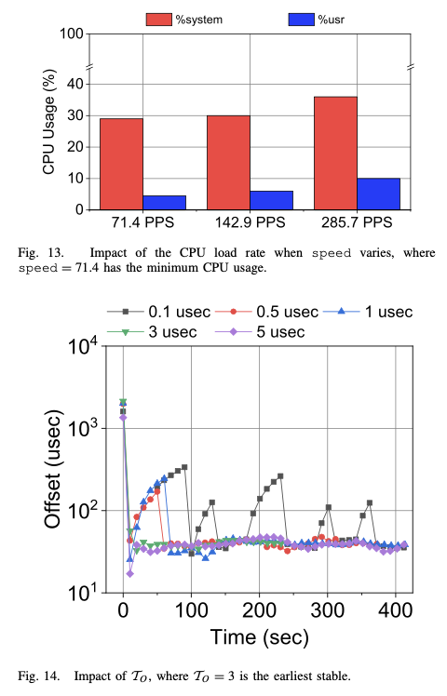
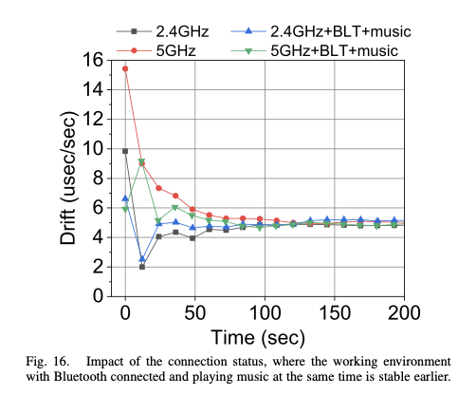
Evaluation
SSA Clock Synchronization

Slide 45
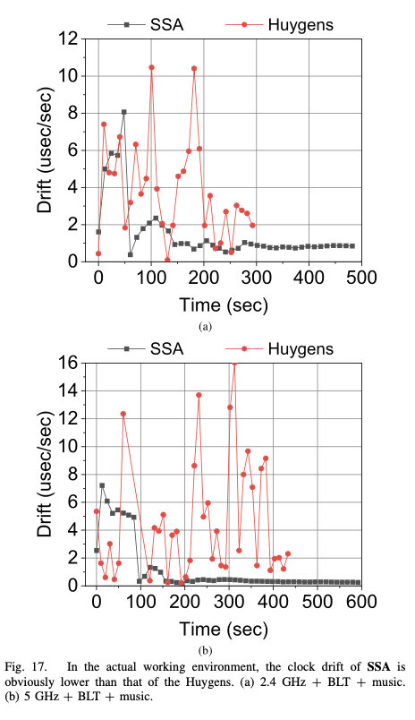
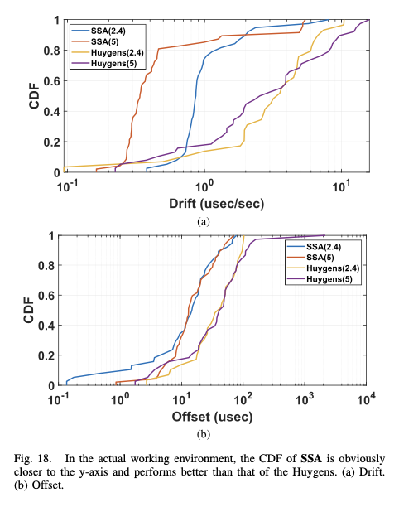
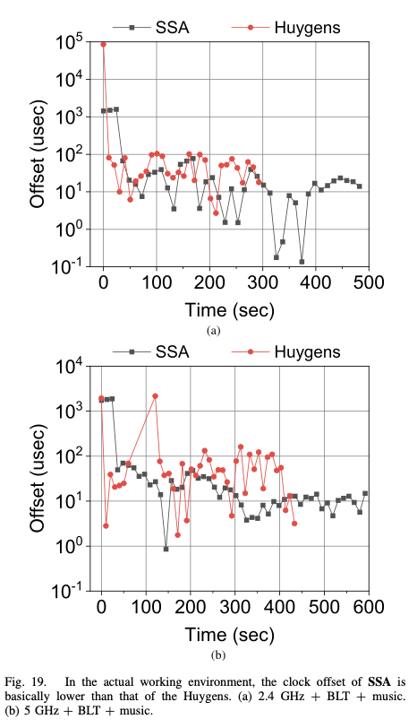
Evaluation – Comparison with HUYGENS
SSA Clock Synchronization
Notes:
System-synthetic experiment results, Comparison with Baseline Huygens without the SSA steps

Slide 46
Graham: Synchronizing by Leveraging Local Clock Properties
Motivation
State-of-the-art systems
          Assume high clock drift (200ppm)
                Performs as many as 10K synchronizations per second to achieve sub-microsecond clock synchronization
But datasheets from several vendors specify a clock crystal with at least ±20ppm temperature stability

Slide 47
Motivation
Graham
If we know that a system has lower drift
    We can reduce the rate of synchronization
      Tolerate synchronization failures
      Reduce network congestion
      Reduce overhead of processing synchronization messages
      Avoid the use of specialized hardware

Slide 48
Contribution
Graham
A comprehensive study to expose that computers can have stable clocks
Characterize computer clocks with existing sensors
A synchronization model to determine clock synchronization frequency

Slide 49
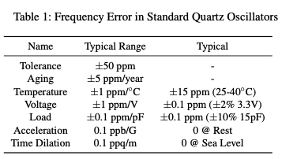
Local clock study
Graham
Clocks in computers are driven by clock signals provided by oscillators.
Clocks drift due to several reasons.
But static drift is relatively constant.
It can be learnt and corrected.

Slide 50
Local clock study
Graham
Dynamic drifts are caused due to environmental changes.
Temperature is the major cause.
Temperature-frequency response of crystals can be determined from crystal datasheet provided by manufacturers
But correcting it is complicate due to physical properties.

Slide 51
Local clock study
Graham
State-of-art systems combine static and dynamic error.
If static error is eliminated, temperature-induced drift is left with ±20ppm.
Spanner assumes 200ppm.
This leads to a 1 µs holdover time of 50ms, a 10x improvement over the 200ppm assumption used by many systems.
Holdover Time refers to how long a clock can maintain accurate time without synchronization.

Slide 52
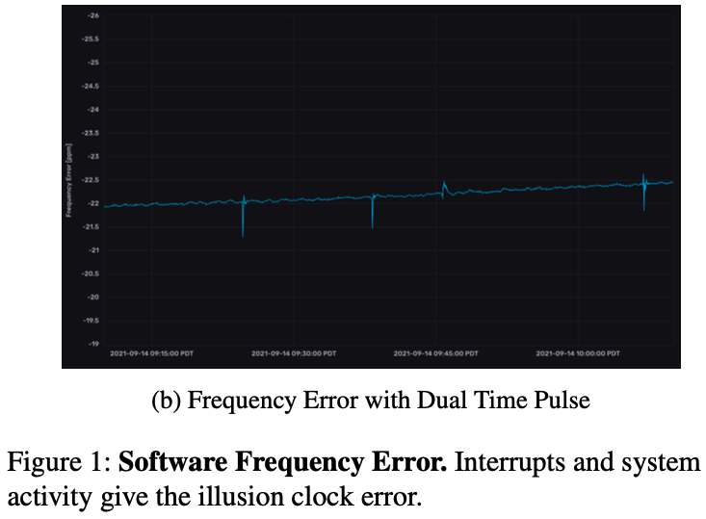
Clock Observations
Graham
Temperature sensors are likely located some distance away from the crystal.
By altering the commodity server to capture low jitter PPS time pulse, Graham identified that the clock was stable over long periods of time, deviating about .5ppm/hour.

Slide 53
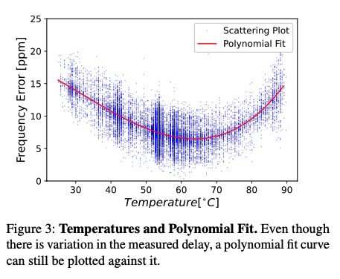
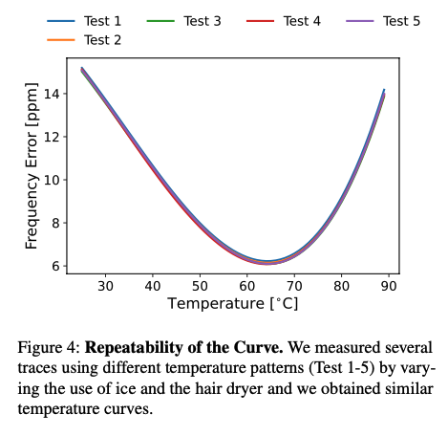
Temperature vs Error relationship
Graham
Raspberry Pi system tested against various temperature ranges gave the polynomial fit curve.
On same device, similar curve is obtained across multiple tests.

Slide 54
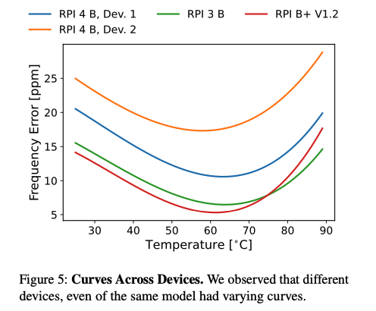
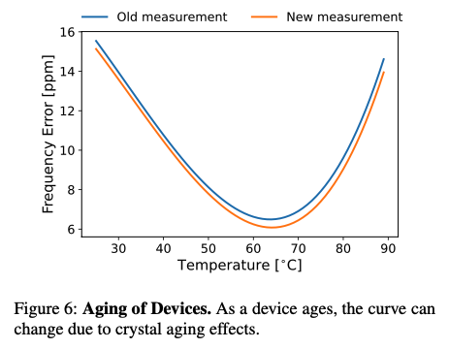
Temperature vs Error relationship
Graham
On different devices of same model, the curve generated is significantly different. Could be due to manufacturing differences.
Curve slightly changes as the device age.

Slide 55
Design
As the clock error can be obtained for a given temperature from the curve, clock can be corrected even in the absence of accurate timing signal.
Graham learns the temperature-clock error relationship by fitting curves as new data points are learned.
Graham

Slide 56
Implementation
The temperature and clock error is modelled by using cubic polynomial equations solved using linear least squares measures.
Graham uses temperature sensors to collect temperature data at regular intervals, assuming operating temperature range of 40-80ºC.
In systems that has more multiple sensors, the sensor with minimal frequency error is selected
The system continuously gathers data and learn the curve before applying corrections.
Jitter and network asymmetry are considered as noise which is a random variable with zero mean that can be reduced by averaging over more equations and longer durations.
Graham

Slide 57
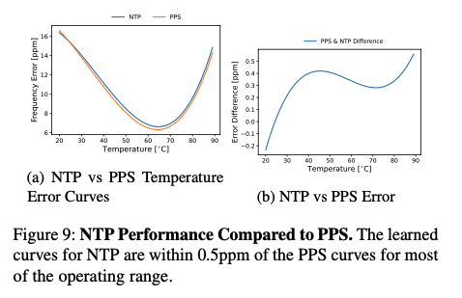
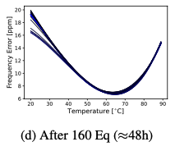
Evaluation
Graham
The evaluation of NTP was performed using chrony to collect synchronization data, with PPS used as the baseline.
NTP synchronization accuracy resulted in a curve within ±0.5 ppm of the PPS baseline across most of the operating range.
It took 160 equations were collected over a 48-hour run to generate this curve

Slide 58
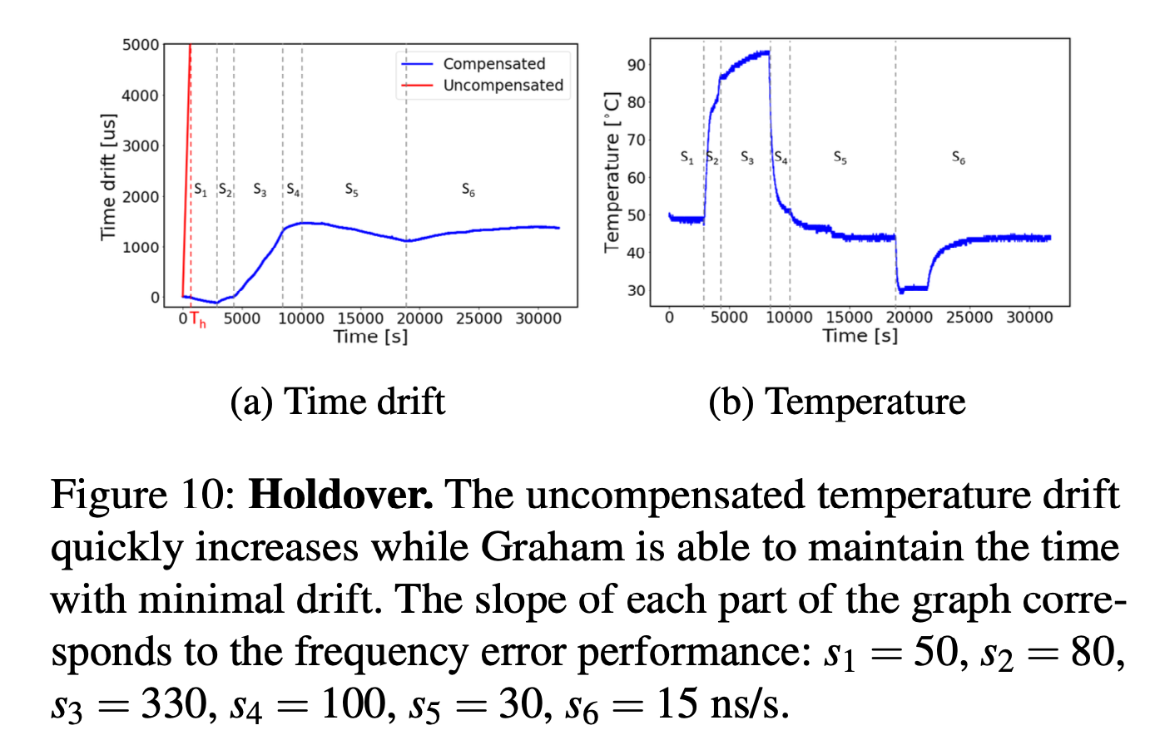
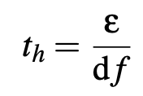
Evaluation
Graham
Holdover in Raspberry Pi 3 environment
Graham correcting time error exceeding 5000μs (5 milliseconds) of drift after 620 seconds, which corresponds to 8ppm of temperature drift.
With Graham's corrections, the error never exceeded 1500μs (1.5 milliseconds) over the 8-hour run, even though the temperature was shifting significantly.
Holdover time
Where e: max. time uncertainty, df: clock drift
If e is 1μs with drift 100ns/s, holdover time is 10 seconds.
i.e., the corrected clock will not exceed 1 μs of error for at least 10 seconds without additional synchronization.

Slide 59
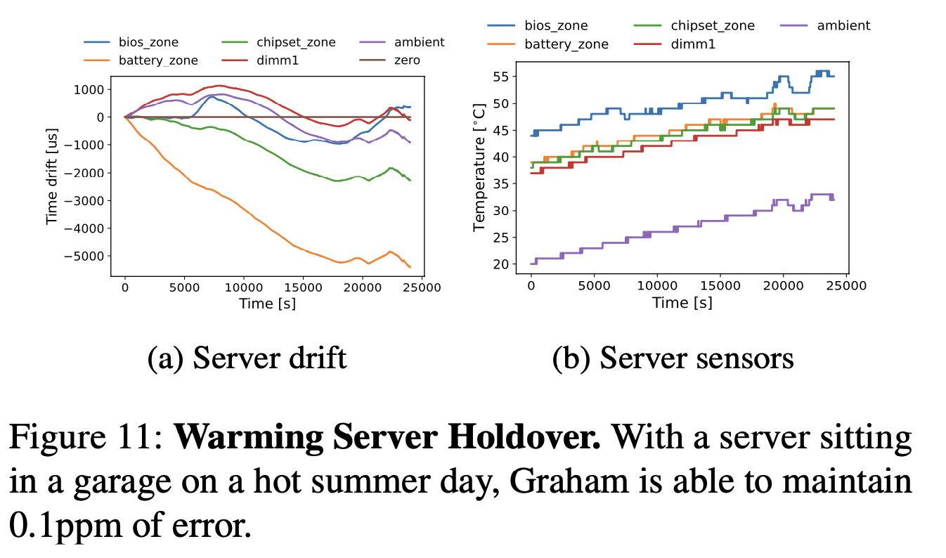
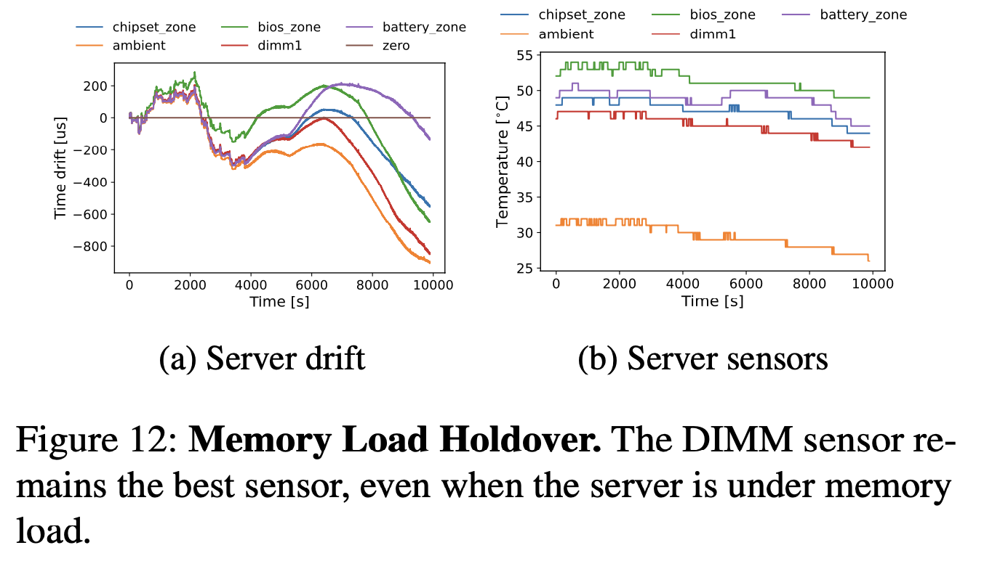
Evaluation
Graham
Holdover server experiment
Experiments were conducted on more complex desktop and server x86 systems with multiple sensors and heat sources.
The DIMM1 sensor maintained excellent holdover performance, producing less than 0.1ppm error, even under a memory load.

Slide 60
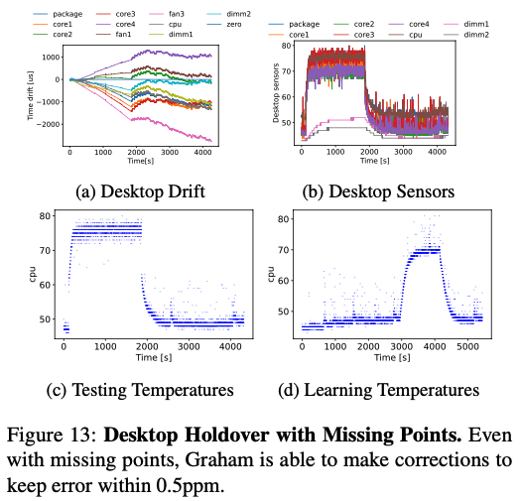
Evaluation
Graham
Holdover desktop experiment
Experiments were conducted on a typical desktop machine, which had fewer sensors exposed compared to the fully instrumented server.
When the testing temperatures were not fully covered in the learning phase, Graham's compensation algorithm was still able to provide some correction, though the error increased from the typical 0.1ppm to 0.5ppm.

Slide 61
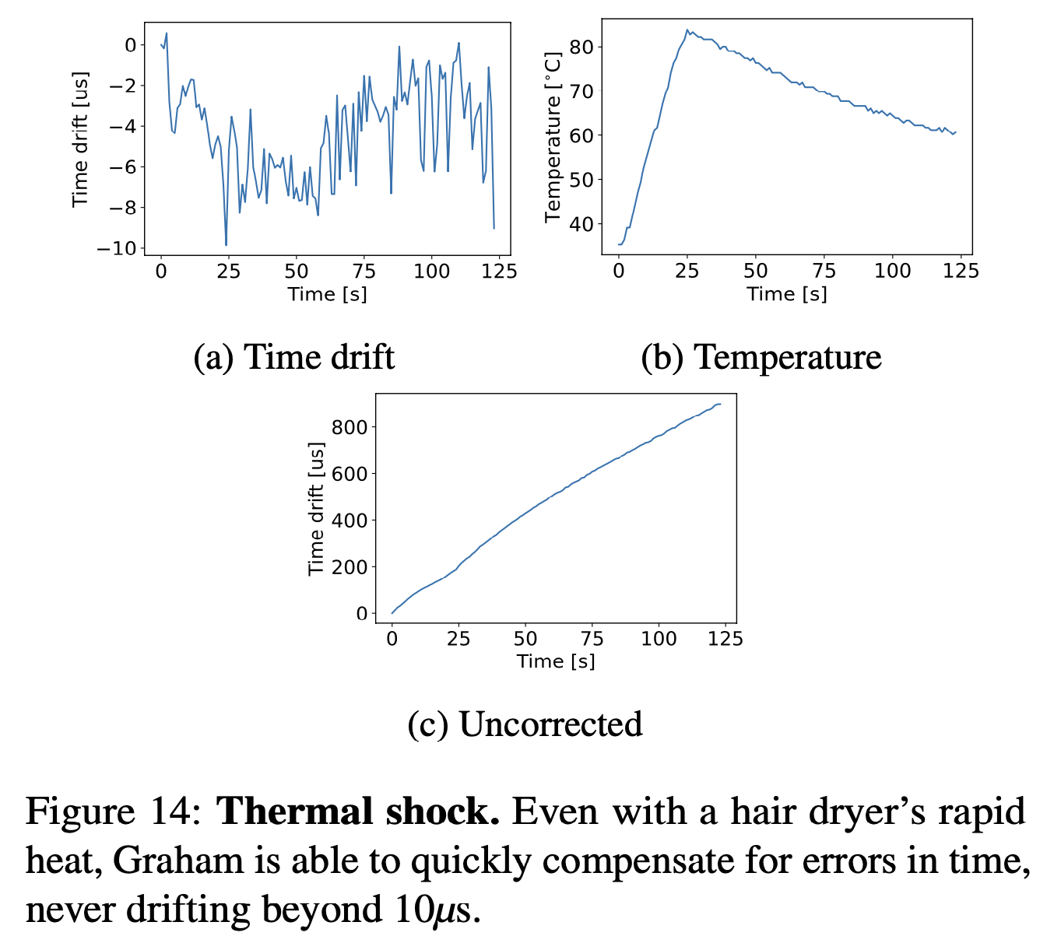
Evaluation
Graham
Temperature rapid changes
Experiments were conducted on a pi machine, raising the temperature rapidly to the maximum operating temperature.
The time drift never exceeds more than 10μs over the initial 25 second slope, a drift of only -0.4ppm.
Once the temperature slope decreases, Graham is able to maintain the time without exceeding the initial 10μs of error.
Without Graham, the system accumulates nearly 1ms of error during this time period.

Slide 62
Conclusion
Graham
Hardware clocks are relatively stable; software noise gives the assumption that clocks rapidly drift.
Graham identified an approach to maintain clock frequency below 1ppm using commodity sensors.
When external synchronization fails, Graham can be relied upon until recovery.
Existing protocols can use Graham in synergy to reduce the frequency of synchronization.

Slide 63
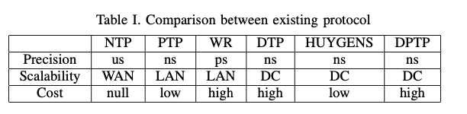
Multi-hop Precision Time Protocol
Motivation & Contribution
Time synchronization is crucial for devices over the Internet
Internet topology is often asymmetric
State-of-art time synchronization protocols are either require expensive hop-by-hop interconnection or are based on the symmetrical structure of the data center

Slide 64
Motivation & Contribution
Multi-hop Precision Time Protocol
The main problem to address is the delay asymmetry in forward and reverse directions.
Most state-of-art protocols assume forward delay and reverse delay are symmetrical, which is not always true on internet.
M-PTP is a high-precision and low-cost time synchronization protocol that uses SVM(like Huygens) to estimate random delay and L-estimator to estimate preliminary time offset.

Slide 65
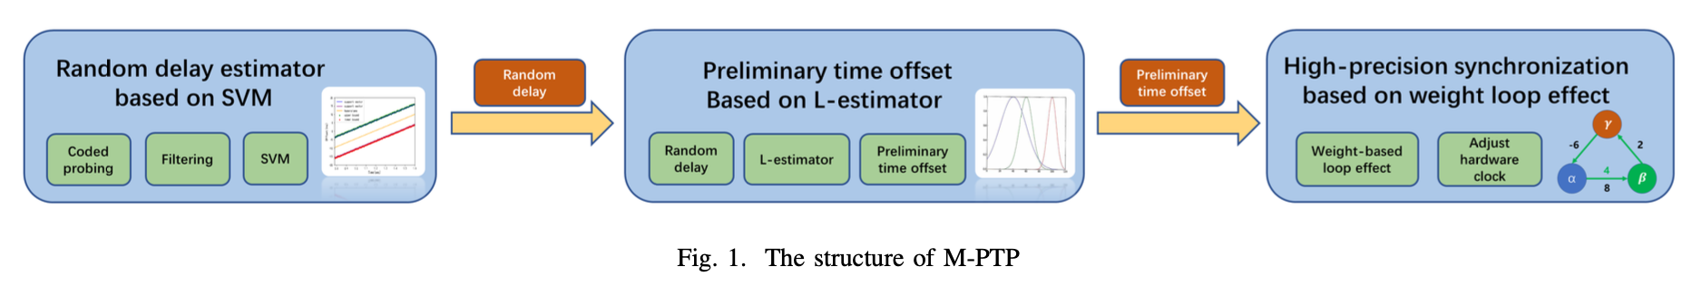
Approach
Multi-hop Precision Time Protocol
3 step clock synchronization protocol
Step 1: SVM-based random delay estimation
Step 2: L-estimator for preliminary time offset calculation
Step 3: Weight-based loop correction for final time offset

Slide 66
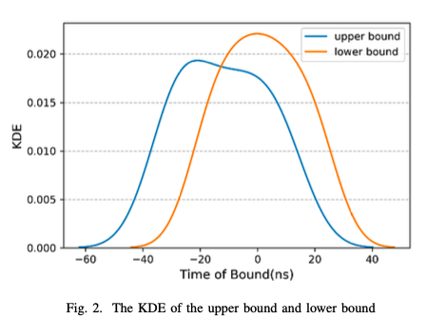

Step 1: Get Random Delay Distribution based on SVM
Multi-hop Precision Time Protocol
M-PTP calculates forward probe(upper bound) and reverse probe(lower bound) using 4 timestamps.
t_{A} and r_{B} are the sending time and receiving time of the forward probe
t′_{B} and r’_{A} are the sending time and receiving time of the reverse probe.
SVM classifies the upper bound and lower bound points and separate them with hyperplane with large intervals.

Slide 67
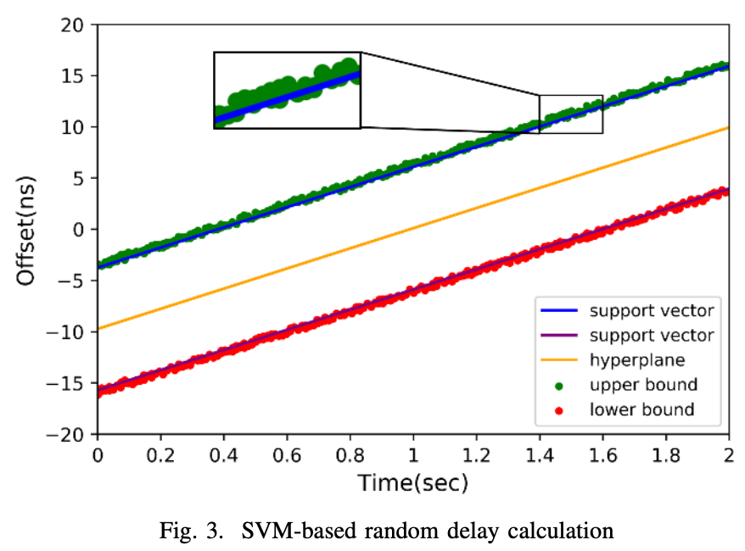
Multi-hop Precision Time Protocol
Step 1: Get Random Delay Distribution based on SVM
Timestamp noise due to write-back delays can cause negative delay, leading to underestimated probe propagation times.
Negative delay is below the upper support vector and above lower support vector.
Forward Random Queuing Delay: Distance between a datapoint above the upper support vector and the upper support vector.
Reverse Random Queuing Delay: Distance between a datapoint below the lower support vector and the lower support vector.

Slide 68
Step 2: Calculate Preliminary Time Offset
Multi-hop Precision Time Protocol
L-estimator is based on Minimax Optimum estimator with superior performance and low computational complexity and requires fewer queuing delay statistics.
Obtain random delay distribution via SVM
For each L-estimator period : Calculate expectation and covariance of queuing delays
Wait until k historical periods are collected
Calculate L-estimator parameters for current and k previous periods
Compute preliminary time offset using these parameters

Slide 69
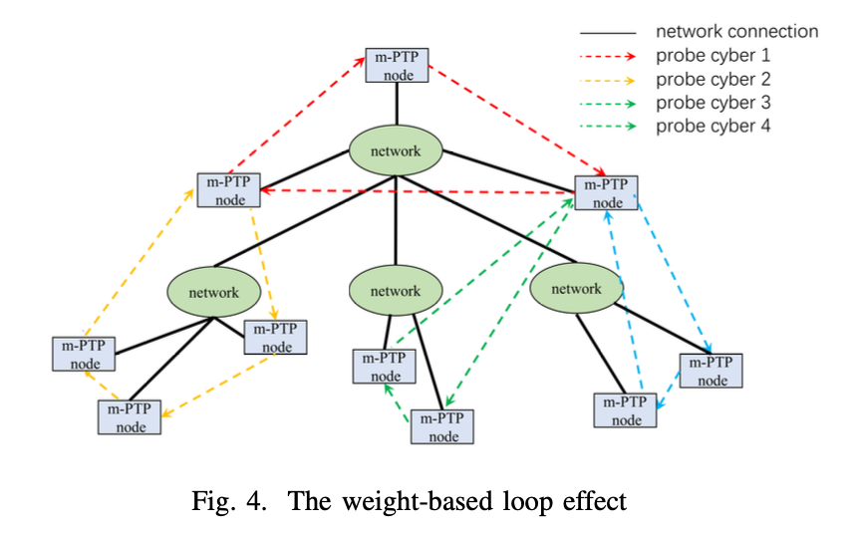
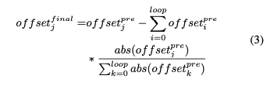
Step 3: Correction based on Weight Loop Effect:
Multi-hop Precision Time Protocol
Ideally, the sum of offsets in a loop should be zero but we see residual sum indicating synchronization errors.
In Huygens, this error is equally distributed.
M-PTP calculates weight on each node based on preliminary offset calculated in step 2 and assign the residual sum of the loop according to the weight and add it to the preliminary time offset.

Slide 70





Evaluation
Multi-hop Precision Time Protocol
Synchronization Precision on Varying Hops (Tested from 1 hop to 5 hops)
Notes:
1 hop: Direct connection between two servers
5 hops: Path through multiple switches

Slide 71





Evaluation
Multi-hop Precision Time Protocol
Mean, Maximum, Minimum, and Variance histograms of the time offset
Notes:
1 hop: Direct connection between two servers
5 hops: Path through multiple switches

Slide 72



Evaluation
Multi-hop Precision Time Protocol
Synchronization precision under different network loads
Synchronization precision under different CPU loads
M-PTP achieves superior time synchronization precision (11.61ns at 5 hops) without hop-by-hop deployment, offering a scalable, low-cost solution for Internet-scale high-precision synchronization.

Slide 73
Sundial: Fault-tolerant Clock Synchronization for Datacenters
Motivation
Time uncertainty bound is the difference between local clock and other clocks.
Time uncertainty bound ε = ε_{base} + (now − T_{last_sync}) × max_drift_rate
  T_{last_sync} : last time when clock is synchronized to the root
  max_drift_rate: constant representing maximum possible drift rate (200ppm)
  ε_{base} : contant accounting other noises
Spanner uses ε to guarantee concurrency control and consistency in distributed databases.
To ensure consistency among snapshots, each node needs to wait for its ε before recording the states.

Slide 74
Motivation…
Sundial: Fault-tolerant Clock Synchronization for Datacenters
State-of-art systems provide 100ms-100ns accuracy but ε grows to 10-100s of μs
Modern datacenter applications with increasing performance requirements and ultra low latency datacenter networks needs more than millisecond level ε

Slide 75

Two key requirements
Sundial: Fault-tolerant Clock Synchronization for Datacenters
1. To keep ε small, we need to reduce now − T_{last_sync} through frequent messaging
Existing systems should reduce sync-interval but software cost is high
2. Datacenter clock synchronization uses a spanning tree with one device serving as root.
Failures that break the connectivity of the spanning tree also affect ε.

Slide 76

Uses a hardware-software codesign
Sundial: Fault-tolerant Clock Synchronization for Datacenters
Hardware
Exchange sync messages, detect failures, sync frequently
Software
Failure handler – reconfigure the hardware
Controller(in software) create backup plan

Slide 77

Sundial: Fault-tolerant Clock Synchronization for Datacenters
Hardware Design - 3 main components
1. Frequent sync messages
On the root, hardware timer triggers transmission message every 100μs
100-byte packet every 100μs consumes < 0.01% bandwidth and ~10ns queuing delay traffic

Slide 78
Sundial: Fault-tolerant Clock Synchronization for Datacenters
Hardware Design - 3 main components
2. Fast Failure Detection
  Hardware uses a timeout counter for upstream failure detection.
  Continuous invalid messages indicate a broken clock, triggers the software's failure handler.

Slide 79
Sundial: Fault-tolerant Clock Synchronization for Datacenters
Hardware Design - 3 main components
3. Time-uncertainity bound calculation
max_drift_rate = 200ppm
εbase = 5ns×depth where depth is the distance of the device from the root in the tree.

Slide 80

Software Design
Sundial: Fault-tolerant Clock Synchronization for Datacenters
Centralized Controller
Pre-calculates backup plans and programs them on the devices based on current topology and configure the devices.
Uses search algorithm to compute fault tolerant backup plan generic to link, non-root, root, domain failures.
Takes only 148ms to run on example Jupiter topology with 88k nodes

Slide 81

Software Design
Sundial: Fault-tolerant Clock Synchronization for Datacenters
Failure Handler
Deamon running in firmware
Responds to interrupts generated by hardware when failure is detected

Slide 82

Evaluation
Sundial: Fault-tolerant Clock Synchronization for Datacenters
Sundial:
  ε ≤ 43ns (matches calculated value).
  Consistently low ε due to precise synchronization; even the deepest devices maintain low ε.
PTP+ε:
  ε up to 800μs for devices not directly synchronized to the root.
  Directly synchronized devices have ε increasing from 5ns to ~400μs (2s sync-interval).

Slide 83
Evaluation
Sundial: Fault-tolerant Clock Synchronization for Datacenters
PTP+DTP+ε:
  ε up to 20μs for non-directly synchronized devices.
  Directly synchronized devices have ε increasing from 6ns to ~6ns (extremely low due to small sync-intervals).
Huygens+ε:
  ε increases from 0 to 400μs during each 2s sync-interval.
  Even with reduced sync-interval, ε remains significantly higher than Sundial's, with a CPU cost.

Slide 84

Evaluation
Sundial: Fault-tolerant Clock Synchronization for Datacenters
Sundial:
  Normal: 15ns-33ns (depth 3).
  Failure: Peaks at 84ns, recovers to 30ns-48ns in 270μs (local recovery).
  Root Failure: 103ns peak, recovery in 365μs.
PTP+ε: ε rises for 2s; remains high even without failure.

Slide 85
Evaluation
Sundial: Fault-tolerant Clock Synchronization for Datacenters
PTP+DTP+ε: Peaks at 40μs, recovers to 20μs; controller delay reduces peak ε only slightly.
Huygens+ε: Unaffected, but high ε (200μs-400μs) during normal operation.

Slide 86
Note
FRANCIS: Fast Reaction Algorithms for Network Coordination In Switches - Claims that it quickly recovers from multiple failures, reduces the time uncertainty bound by up to 5x, and lowers the clock drift when compared to sundial through programmable switches.

Slide 87
Time synchronization using deep learning
Unsupervised Deep-Learning for Distributed Clock Synchronization in Wireless Networks
The paper is related to the study of clock synchronization in wireless networks but I could not clearly understand it.
Their code is at github

